Slide 1
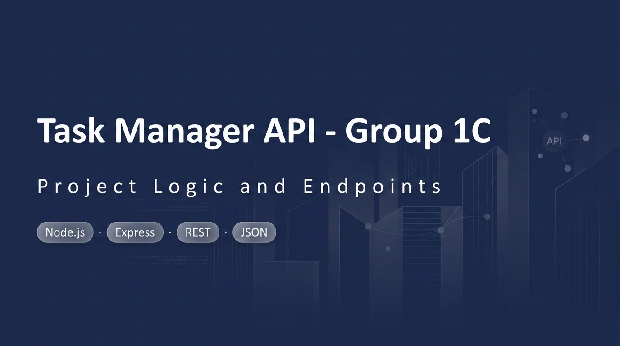

Slide 2
Project logic: request flow
Client request
express.json()
Validation middleware
Route handler
JSON response
Middleware runs first: it rejects with 400 or calls next().
Handlers read or change the tasks array, then respond.
Unknown ids return 404; unexpected errors reach the error handler (500).
Data lives in memory, so it resets when the server restarts.

Slide 3
Data model and validation
id: number, unique
title: string, required
description: string, required
status: "pending" or "completed" (case-insensitive check)
Create requires all three fields; update checks status only if sent

Slide 4
Endpoints
Method | Path | Purpose | Success
GET | /api/tasks | List all tasks | 200
GET | /api/tasks/:id | Get one task | 200
POST | /api/tasks | Create (validated) | 201
PUT | /api/tasks/:id | Update a task | 200
PATCH | /api/tasks/:id | Partial update | 200
DELETE | /api/tasks/:id | Delete a task | 204

Slide 5
Status codes
The status codes tell the client what happened:
200 success
201 created
204 deleted, with no body
400 the client sent bad data
404 the task was not found
500 the server failed

